Slide 1

TinyALU
Verification
presented by
Ahmed Abdellatif - Ahmed Amr - Ahmed Essam
Aya Hassan - Eman Yasser - Essraa Khlaed - Passant Nabil

Slide 2

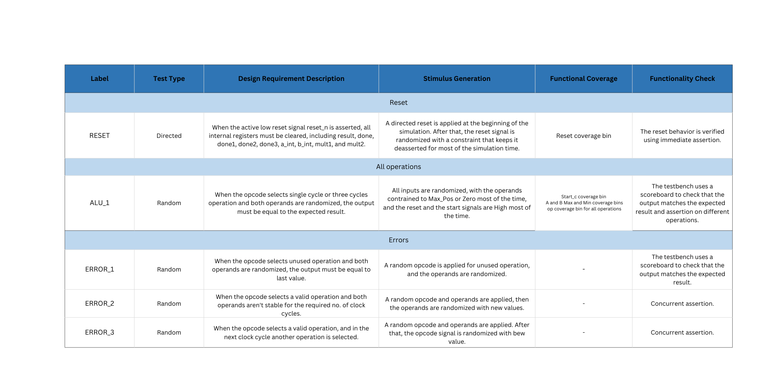

Verification Plan

Slide 3
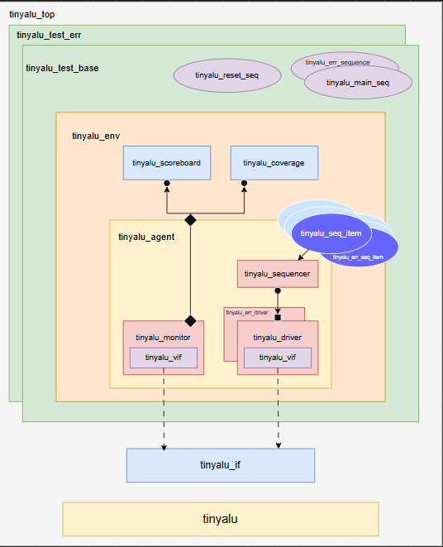
Architecture

Slide 4
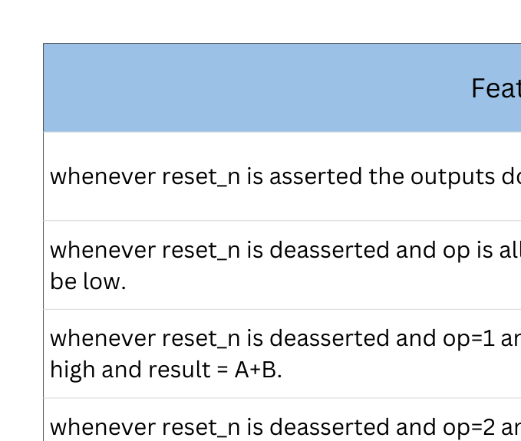
Assertions

Slide 5
Reference Model
A reference model was implemented based on the given specifications:
When the start signal is asserted, The ALU executes the operation selected by the opcode.
The input operands must remain stable from the assertion of start until the result is generated.
The operation completes when the done signal is asserted.
The ALU supports:
1. Three single-cycle operations: ADD - AND - XOR
2. One multi-cycle operation: MULT

Slide 6
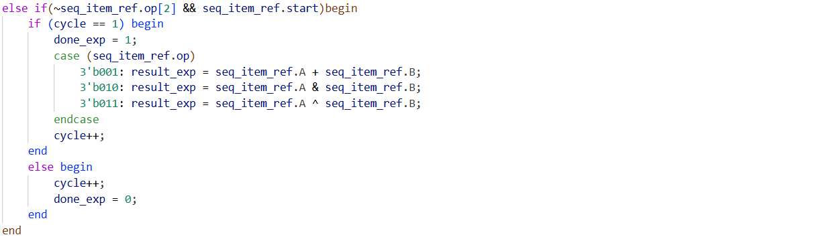
Scoreboard
single-cycle operations: ADD - AND - XOR
Compute the result of single-cycle operation

Slide 7
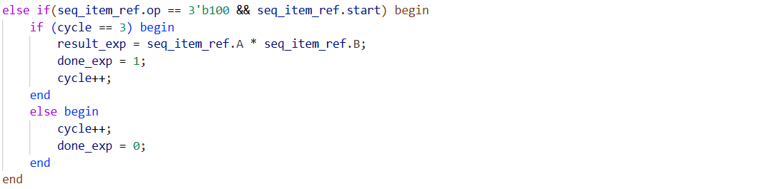
Scoreboard
Three-cycle operation: MULT
Compute the result of multi-cycle operation

Slide 8
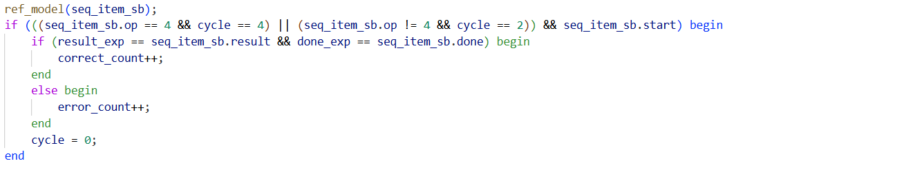
Scoreboard
Comparison Between Expected Output and DUT Output
The scoreboard checks correctness by comparing the DUT output against the expected result calculated by the reference model.

Slide 9
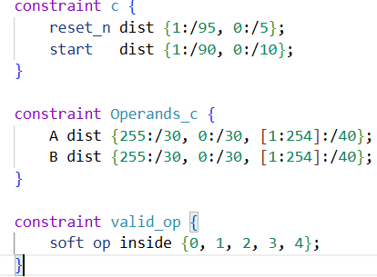
Sequence item
We have created sequence item represents the transaction that will be sent to the DUT
The sequence item generate a randomized inputs under some defined constrains based on our specs as shown:
The reset signal to be off most of the time
The Start signal to be asserted most of the time
The Operands A,B to have its Maximum or Minimum values most of the time to achieve the required corner cases
The opcode to be away from the unused cases

Slide 10
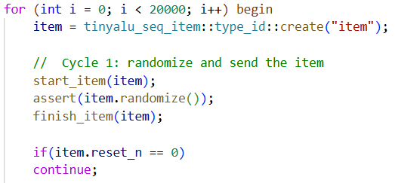
Main sequence
Generate test transactions for the TinyALU.
Randomize the item.
Check if reset_n is active,we go for continue and go to new operation.

Slide 11
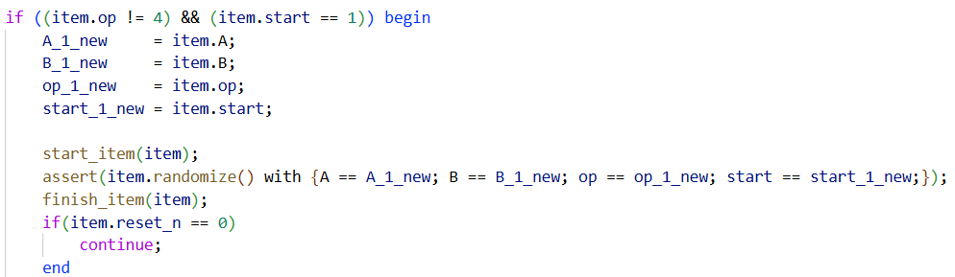
Main sequence
Single cycle :
Single-cycle operations: Any op except 4.
Save A, B, op, start to ensure the input values are stable during the operation.
Send the item to the driver again with the same values to ensure deterministic behavior.
Save A, B, op, start
Randomization with Constraints,we force the randomized item to match saved values.

Slide 12
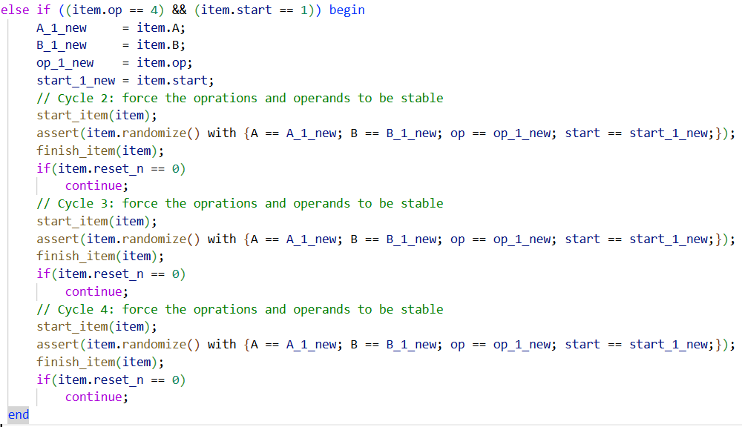
Main sequence
Multi cycle

Slide 13
Why Error Injection?
Normal tests verify correct behavior under valid inputs
Error injection tests verify:
Robustness of the design
Proper error detection and handling
What happens if the protocol is violated?
Does the design fail safely?

Slide 14
Error Injection Strategy
Error injection is implemented by extending the normal test components:
Sequence item
Sequence
Driver
Test
The base functionality is fully reused
Additional error behavior is added without modifying the original code
UVM Factory Override is used to:
Replace the normal sequence item with an error-aware sequence item
Replace the normal sequence and driver with error-capable versions

Slide 15
Error injection testcases
In our error injection tests we aimed to violate two main feature of the specs which are:
The opcode and the operands must remain stable along the operation until the signal done is asserted
opcodes 3'b101-3'b111 will be unused
So we created three test error testcases:
op_stable_err: in which we will remain the operands stable but change opcode during the opeation
operands_stable_err: in which we will remain opcode stable but change the operands during the operation
invalid_opcode: where we will try to inject the unused opcodes

Slide 16
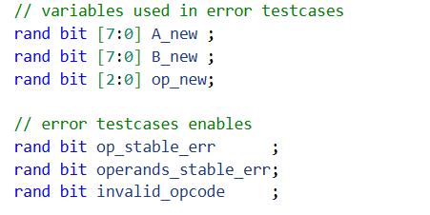

Changes in error sequence item
First we added some signals to the base sequence item
To store the values of the opcode and operands at the begging of operation
To choose which of the testcases will be used

Slide 17
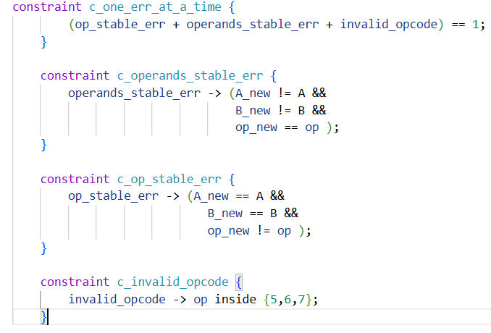
Changes in error sequence item
Then we added another error sequence item which extends from the base sequence item and have the following constrains
To have one error testcase active at time
To choose which will be changed and which remain stable based on the testcase
To force opcode to be one of the unused values if it’s the active testcase

Slide 18
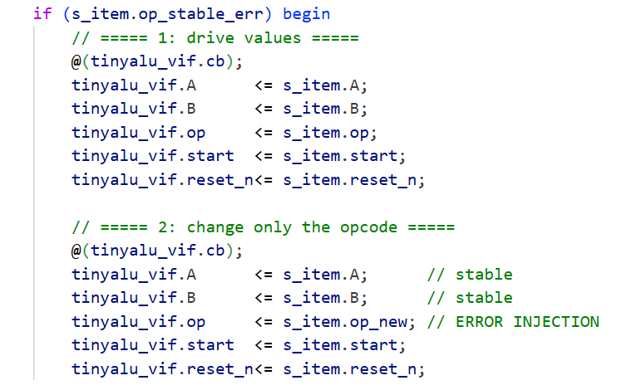
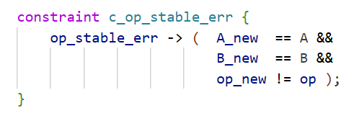
How Errors Are Driven
Driver checks error flags and:
Drives normal values in the first cycle
Drives corrupted values (*_new) in the next cycle
Determine the error type to drive accordingly
Drive different opcode

Slide 19
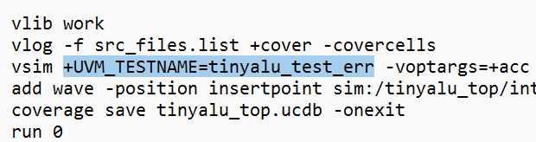
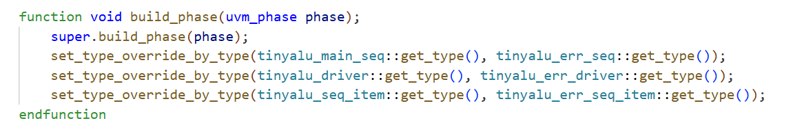
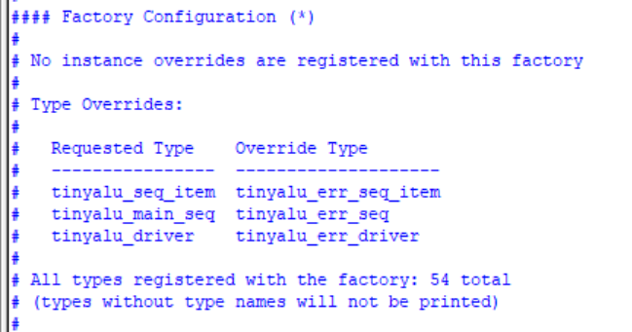
Changes in Error Test
Error test extends the base test
Overrides the base components with errored one.

Slide 20
Coverage
Code coverage
measures coverage of the design structure (branch, statement, toogle, etc.).
measures how much of the implementation has been exercised.
Functional coverage
measures of which design features have been exercised by the test
to ensure that the verification process has exercised the design through all of the interesting values.

Slide 21
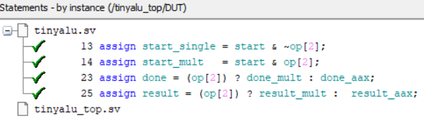
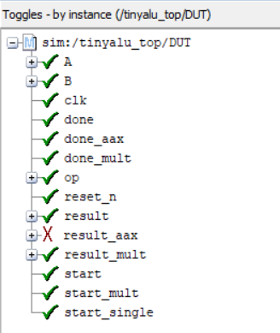
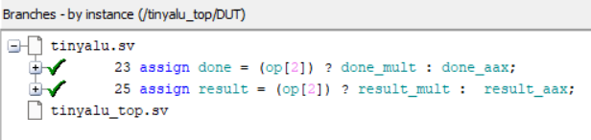
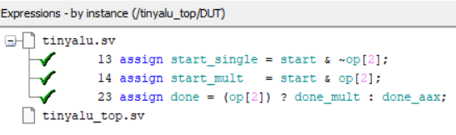
Code coverage

Slide 22
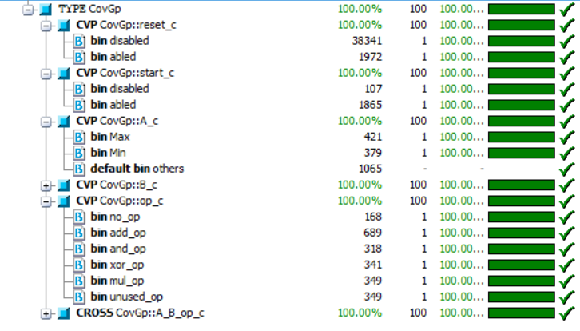
Functional collector

Slide 23
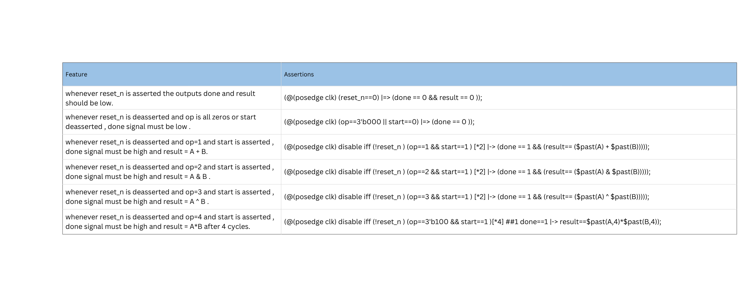
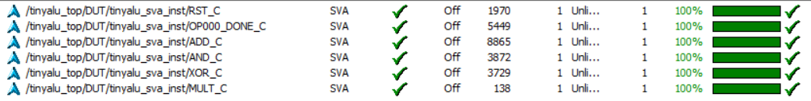
Assertions

Slide 24
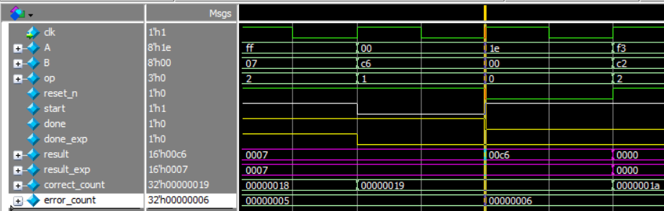
Bugs in the DUT
First Bug
The output doesn’t depend on the start.
As we can see at “op”=1 the “start”=0 so the result should be the same as previous ,but here the DUT execute the operation.

Slide 25
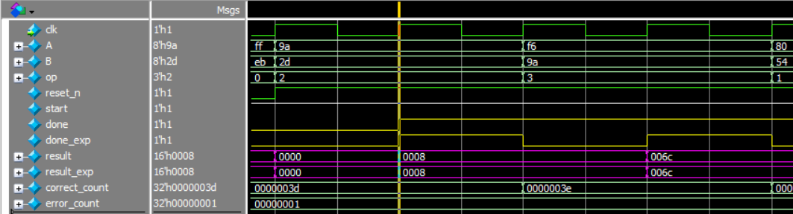
Bugs in the DUT
Second Bug
The “done” signal doesn’t go back to ‘0’ after the operation.
As we can see the “done” signal keeps high for multiple periods.
Specs: The done signal stays high for only one clock.
We disabled the “done” to see the other bugs

Slide 26
Thank You

